Slide 1
Auto Components Scan Annotation Types
@Component
Indicates a auto scan component.
@Controller
Indicates a controller component in the presentation layer.
@Service
@Repository
Indicates a Service component in the business layer.
Indicates DAO component in the persistence layer.
Which one to use? It’s really doesn’t matter. we will see why?

Slide 2
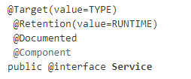
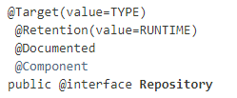
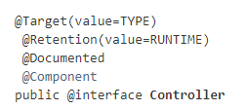
Auto Components Scan Annotation Types
We can noticed that all @Repository, @Service or @Controller are annotated with @Component. So, we can use just @Component for all the components for auto scanning and Spring will auto scan all our components with @Component annotated. It will work fine, but not a good practice, for readability, we should always declare @Repository,@Service or @Controller for a specified layer to make your code more easier to read

Slide 3
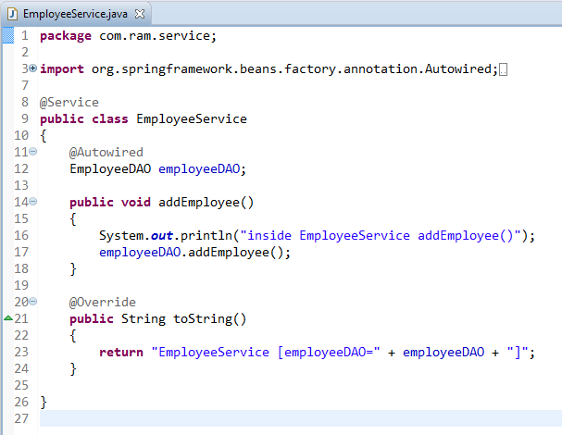
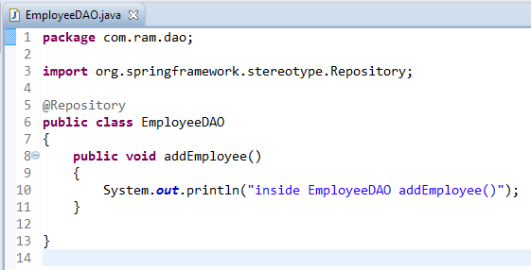
Auto Components Scan Annotation Types

Slide 4
Auto Components Scan Annotation Types
Application xml

Slide 5
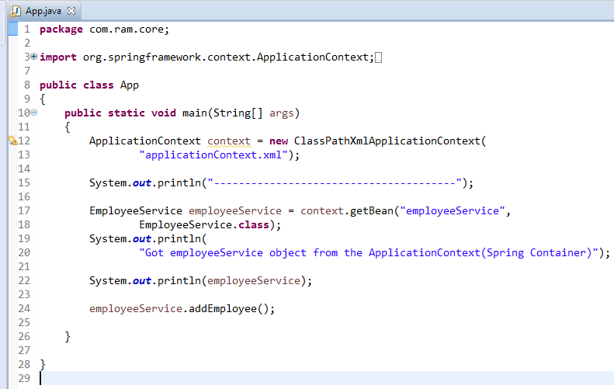
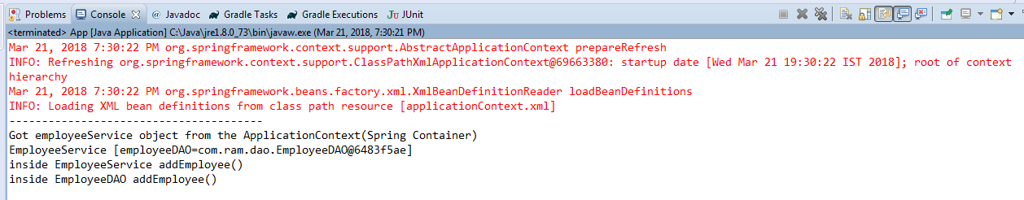
Auto Components Scan Annotation Types

